Slide 2
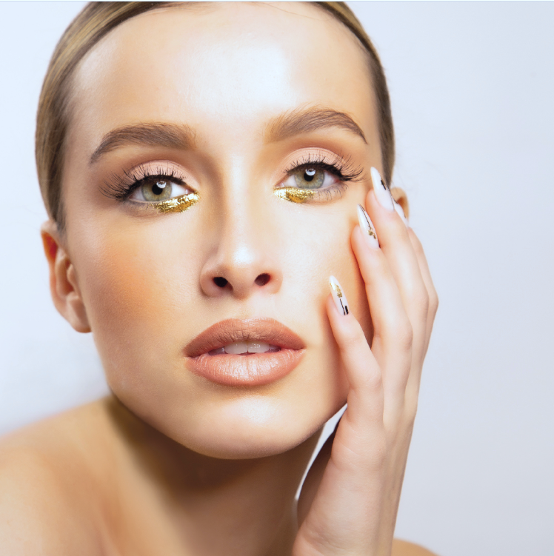
How to submit your work
How to Submit Your Lash and Brow Competition Entry:
Purchase Your Kit:
Get your competition kit from an authorized distributor in Norway (Nordic Beauty Trend or Brow Rehab) or in Sweden (Nordic Beauty Trend or Victoria’s Brows).
2. Submit Your Entry :
Email your participation photo to championship@thuya.no. Include the unique code you received upon registration; this code must appear in each of your submission photos.

Slide 3
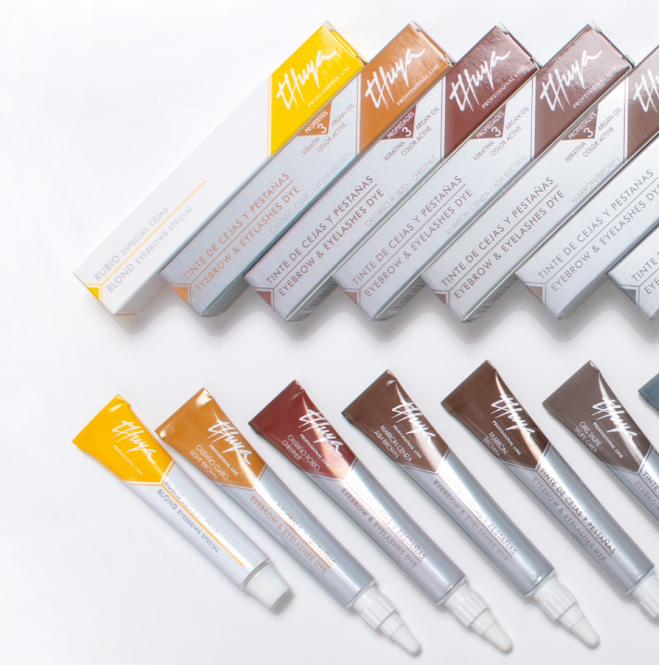
Submission Instructions
Write your code on an A5 or A4-sized paper, and make sure this paper is visible in every photo you submit for both categories—Lash Lift or/and Brow Lamination
Photos submitted without the code will be disqualified.

Slide 4
SUBMISSION PERIOD
You can submit your work from November through February
JUDGING AND RESULTS:
Judging will take place from March 1 to March 7, and results will be announced on our websites on March 8.
INTERNATIONAL FINAL
The international final will be held in Barcelona in May; the exact date will be confirmed soon

Slide 5
Good luck to all participants! We look forward to seeing your work.

